Slide 1
Spring Nalys graduate program

Slide 2
What is Spring ?
Framework replacing J2EE
Enterprise development level without application server
POJO Based
Annotation Based

Slide 3
Why Spring ?
Testability
Maintainability
Scalability
Complexity
Best practices and design patterns
Abstraction of underlined technology
Convention over configuration

Slide 4
How it works ?
Spring container
POJOS
HashMap

Slide 5
Fleet Management System

Slide 6
XML Configuration
Separate configuration from code
Application Context

Slide 7
Beans
Instance of classes
Singleton
Prototypes
Specific scopes for WebMVC
POJO
Created by Spring, no need of keyword new
Define class, use interface

Slide 8
Dependency Injection
Constructor injection
Setter injection
Autowiring

Slide 9
Annotations
Component Scanning
@Component
@Service
@Repository
Autowiring

Slide 10
JavaConfig
@Configuration on classes
@ComponentScan
@Bean

Slide 11
Spring properties
Properties file or YAML
@PropertySource

Slide 12
Spring MVC Nalys graduate program

Slide 13
What is Spring MVC
MVC : Model View Controller
Web Framework
POJO Based and interface driven
Annotation based
Based on Dispatcher Servlet / Front Controller pattern
Very lightweight : Take what you want
Based on Java Servlet or JEE

Slide 14
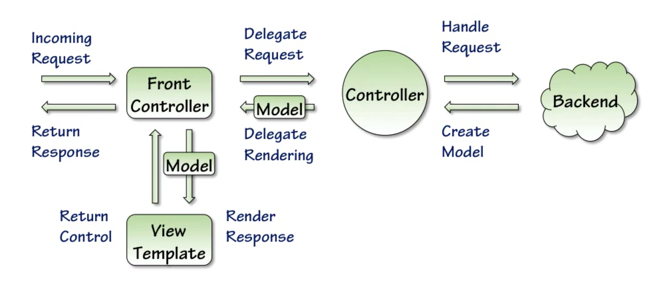

Slide 15
Dispatcher Servlet
A central dispatcher for HTTP request handlers/controllers.
Dispatches to registered handlers for processing a web request, providing convenient mapping and exception handling facilities.

Slide 16
Controllers
Annotation Based @Controller
Handles incoming requests
@RequestMapping for mapping method to URLs
Work with Services / Business Logic
Routes to view
Handles Exception (@ExceptionAdvice)

Slide 17
Services
POJO annotated with @Service
Where the business logic is
Validate object from a business POV
Triggers transactions

Slide 18
Repository
POJO annotated with @Repository
Interact with the database

Slide 19
REST Controllers
CRUD : Create, Read, Update, Delete
POST
GET
PUT
DELETE

Slide 20
Spring Data JPA Nalys graduate program

Slide 21
What is JPA ?
JPA is an abstraction layer to communicate with a database system
Uses dialect in order to communicate with a specific product

Slide 22
JPA with Spring
Let’s inject everything
Persistence Java Config
@Transactionnal

Slide 23
Spring Data JPA
Remove boilerplate code
Repositories are automatically implemented by Spring for simple queries
@Query can be used for more elaborated queries

Slide 24
Spring Boot Nalys graduate program

Slide 25
Spring Boot testing

Slide 26
Spring boot dependency management
BoM (Bill of material) : Collections of dependencies

Slide 27
Spring Boot App
@SpringBootApplication
@EnableAutoConfiguration : Convention over configuration

Slide 28
Quentin Loos quentin.loos@gmail.com

